Slide 1
Section 2.4 Recursive Sequences and Series
i) Concept of Recursive Sequences
ii) Fibonacci Sequence
iii) Phone Tree
iv) Rabbit Population Question
© Copyright all rights reserved to Homework depot: www.BCMath.ca

Slide 2
I) Telescoping Series
A series where many terms in the series cancel each other out and a fixed number of terms are left for the sum
Ex: Find the sum of the series:

Slide 3
An extension of the telescoping series is when the terms in the denominator differ by more than one
Ex: Find the sum of the series:

Slide 4
Sum of squares:
Note: Here are some basic formulas
Start off with this formula for the basic proof of sum of squares:

Slide 5
Take the sum of all the rows

Slide 6
Challenge: Find the sum

Slide 7
What are recursive Sequences:
A recursive sequence is a sequence where each term (t_{n}) is defined from earlier terms (t_{n-1} or t_{n-2}) in the sequence.
Examples:
  2, 4, 6, 10, 16, 26, 42,….
  2, 4, 7, 27, 188, …..
  1, 2, -3, -5, -16, …..
  The Fibonacci Sequence: 0, 1, 1, 2, 3, 5, 8, 13, 21, 34, 55, ……
Ex: Given that t₁ = 0, t₂ = 3 and t_{n}= t_{n-1}+2 (t_{n-2}), find t₇
Sum of the previous two terms
Product of the previous two terms minus one
t_{n} = (t_{n-2})² – (t_{n-1})²

Slide 8
Ex: Find the first 4 terms of the sequence
The first four terms will be:

Slide 9

Applications of Recursive Sequences:
Programming: C++, C
  Using input from a previous code
Nature:
  Plants, tree branches, flowers (# of leaves)
Golden Ratio/Fibonacci Numbers
Count the number of
branches in each stage
The number of branches
in each stage is the same
as the Fibonacci sequence

Slide 10
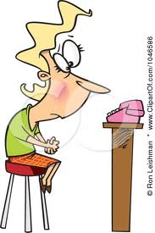



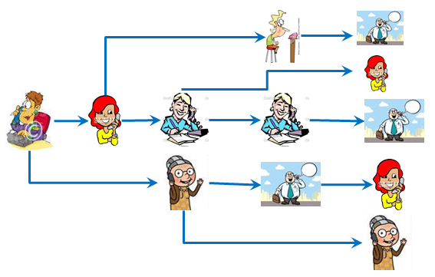






Ex: A principle starts a phone tree by calling 2 teachers. Each teacher is to call two other teachers down the tree. If there are 500 teachers in the school and each call takes 2 minutes, how long will it take to phone all the teachers if the first phone call started at 9:00pm?

Slide 11
The number of teachers in each level is a recursive sequence:
Each additional level will be an extra 2 minutes to contact everyone
Figure out at which level will a total of 500 people be contacted
By the 13th level, all 500 teachers will be contacted
The amount of time to contact all teacher at the 13th level will be:
Therefore, all teachers will be contacted by 9:24pm.

Slide 12
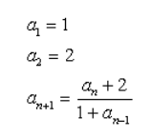
Ex: What are the 4th, 5th and 6th terms of this sequence?

Slide 13
Challenge: Given the equation:
Evaluate the following:

Slide 14
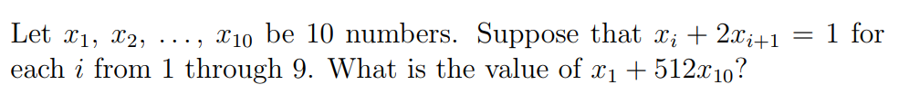
Math Prize for Girls

